Slide 1
BY - Priyansh gupta (153/CSE/16162)
Nimmala Vishnu (178/CSE/16022)
3rd year Project ,IIIT KALYANI
Mentor:
Dr. SK HAFIZUL ISLAM
INTRUSION DETECTION SYSTEM
USING BLOCKCHAIN TECHNOLOGY

Slide 2
Intrusion Detection System
Introduction : IDS is a technology to detect the malicious and unethical activity. Intrusion detection describes the process of monitoring network or system events for any sign of possible incidents.
IDS can be categorized into host-based IDS (HIDS) and network-based
IDS (NIDS)
A host-based intrusion detection system (HIDS) is a system that monitors a computer system on which it is installed to detect an intrusion and responds by logging the activity and notifying the designated authority.
NIDS analyzes network traffic at all layers of the Open Systems Interconnection (OSI) model and makes decisions about the purpose of the traffic, analyzing for suspicious activity.

Slide 3
Intrusion Detection System
IDS can also be divided into two types based on detecting the attack or anomaly. one is Signature based and another is anomaly based.
The signature-based detection identifies an attack by comparing its stored signatures against observed system or network events for potential incidents. A signature (or rule) is a kind of pattern describing a known attack or exploit.
The anomaly-based detection finds a suspicious activity by identifying significant deviations between pre - existing records and newly data.
compare the behaviour based on their attributes and charteristics.

Slide 4
Blockchain Technology
Blockchain is digital ,decentralized ledger where we can store our data .
blockchain is a datastructure where each block os linked to another block in a time-stamped chronological order.
Blockchain is managed by the peer to peer network .
By design, a blockchain is resistant to modification of the data.it means once data is information is recorded then data is any block can’t be altered .each block has unique hash key.
blockchain is highly fault tolerant as there is no single point of failure.

Slide 5
Use of Blockchain Technology in IDS
Blockchain technology is used to store data in the block with unique hash key associated with it . if any anomaly will come into the system and try to change or destroy the data then hash key will change automatically.
we store data in the database like blockchain then blockchain technique is very useful to detecting the attack by comparing the hash key after the transaction and before the transaction.if hash key remain same then their is no any attack , else attack happened.

Slide 6
Blockchain implementation in python
python has many inbulit libraries to generate the hash key. from which we used hashlib library .we used time function to attach the time with the block.
We have stored one data in “block2” in the chain.
import hashlib
gen_hash = hashlib.sha3_256()
gen_hash.update(pickle.dumps(block2))
gen_hash.digest()
gen_hash.hexdigest() # hash key is generated

Slide 7
Machine learning to classify the Message
Machine learning is the field of study where it allows machine to learn from training data or do or perform the task automatically without any human-itervention and being explicitely programmed. Machine learning has so many algorithms to train the model and classify the messages.
we have used SVM (support vector machine) algorithm .
SVM is supervised ml algorithm which uses predefined data or information the classify the newly message .
we will use this in signature based detection IDS.

Slide 8
Support Vector machine
Algorithm
SVM is supervised machine learning algorithm used to classify our dataset. because SVM treats every feature of data equally.
In this algorithm, we plot each data item(information of the data which is being sent through the internet) as a point in n-dimensional space (where n is number of features you have) with the value of each feature being the value of a particular coordinate.
Then, we perform classification by finding the hyper-plane that differentiate the two classes very well.

Slide 9
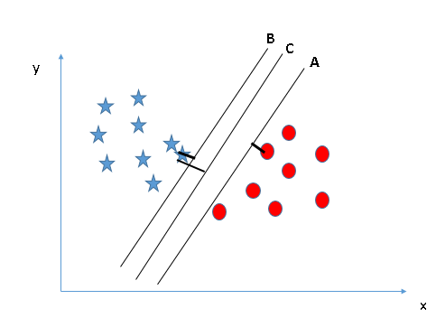
Support Vector machine
Algorithm
IDS uses a linear classification algorithm. we are going to perform here linear SVM. .
calculate the distance from each data point to hyper plane (called margin)
margin should be larger for best classificaiton.

Slide 10
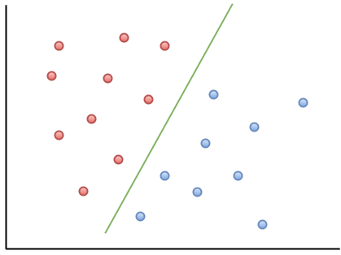
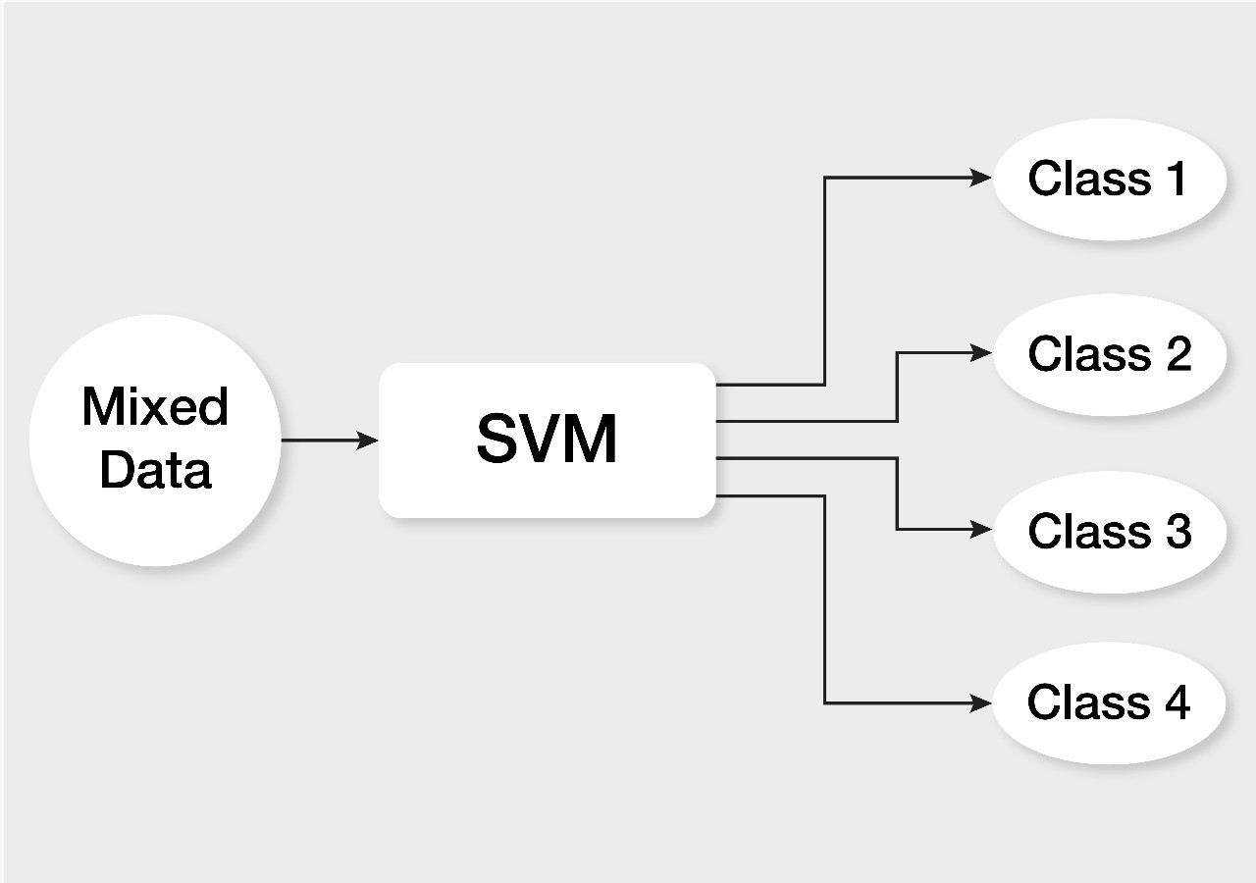
Support Vector machine
Algorithm
SVM has a feature to ignore outliers and find the hyper-plane that has maximum margin. Hence, we can say, SVM is robust to outliers.

Slide 11
Suppport vector machine
Implementaion in python
In python we have powerful library called scikit-learn which has all machine learning algorithms . SVM is one of those.
we used python3.x , sklearn , pandas , numpy and many other libraries to get the disered result.
First we have cleaned the whole data and then train our model using svm algorithm.
>> from sklearn import linear_model, svm
>>from sklearn.svm import SVC
after all processing we have more than one classes of messages.

Slide 12
Thank You
Priyansh Gupta (CSE/16162/153)
Vishnu Nimmala(CSE/16022/178)
Computer Science and Engineering,
Indian Institute of Information
Technology Kalyani,
Webel IT Park, West Bengal 741235,
India

